Slide 1


Unit Testing - MyYear13
Jest is a delightful JavaScript Testing Framework with a focus on simplicity. It works with projects using: Babel, Typescript, Node, React, Angular, Vue and more!
Vue Test Utils is the official unit testing utility library for Vue.js. Providing comprehensive API to interact and assert Vue component (data, props, computed properties, methods, emit, Vuex…)
+
Notes:
- Jest is open source and maintained by Facebook
- Vue Test Utils: Vue team

Slide 2
Unit Testing - MyYear13
The three steps of Unit Testing:
arrange (set up for the test. In our case, we render the component).
act (execute actions on the system)
assert (ensure the actual result matches your expectations)

Slide 3
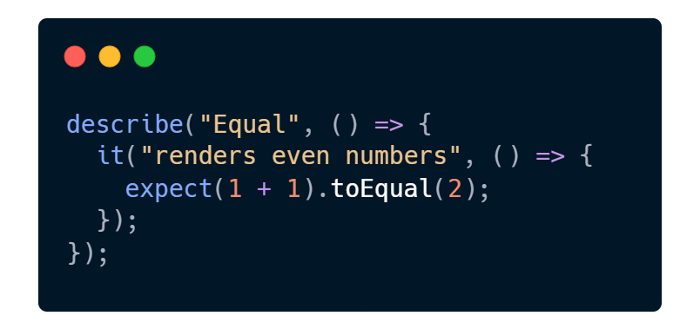

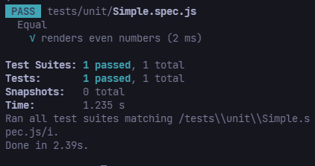
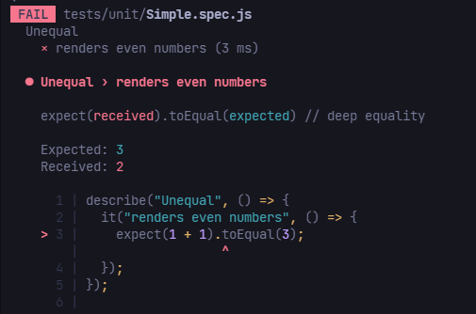


Test case - Result

Slide 4
Demo Flow
1. Set up a test case – Simple.spec.js
2. Rendering Components – Greeting.spec.js
3. Testing Props, Data – SubmitButton.spec.js
4. Computed Properties – NumberRenderer.spec.js
5. Simulating user input – FormSubmitter.spec.js
6. Testing emitted event – Emitter.spec.js
7. Mocking global objects (Injections) – FormSubmitter.spec.js
8. Stubbing components - ParentWithAPICallChild.spec.js
9. Vuex – Feel free to explore yourself

Slide 5
References
Vue Test Utils’ Doc: https://v1.test-utils.vuejs.org/guides Rendering Components
Vue Testing Handbook: https://lmiller1990.github.io/vue-testing-handbook/
Vue School: https://vueschool.io/courses/learn-how-to-test-vuejs-components

Slide 6

Thank you!

